Slide 1
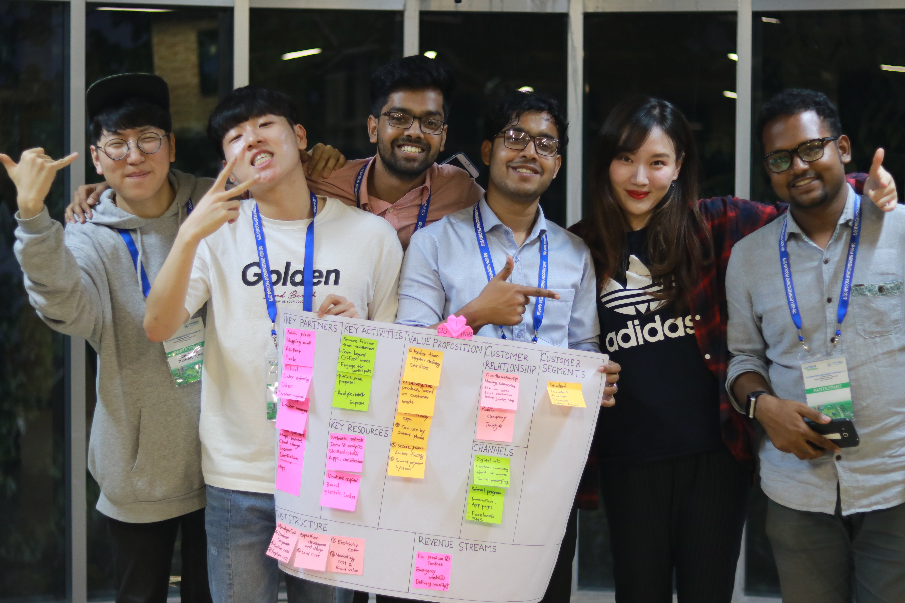
WELCOME
KIM |LEE|HEO|FARHAN|ASHIK|MUNNA

Slide 2
Who We Are?
BOGANI
Keep things Safe
BOGANI comes with a very new concept in Bangladesh, Mostly for Travelers.

Slide 3
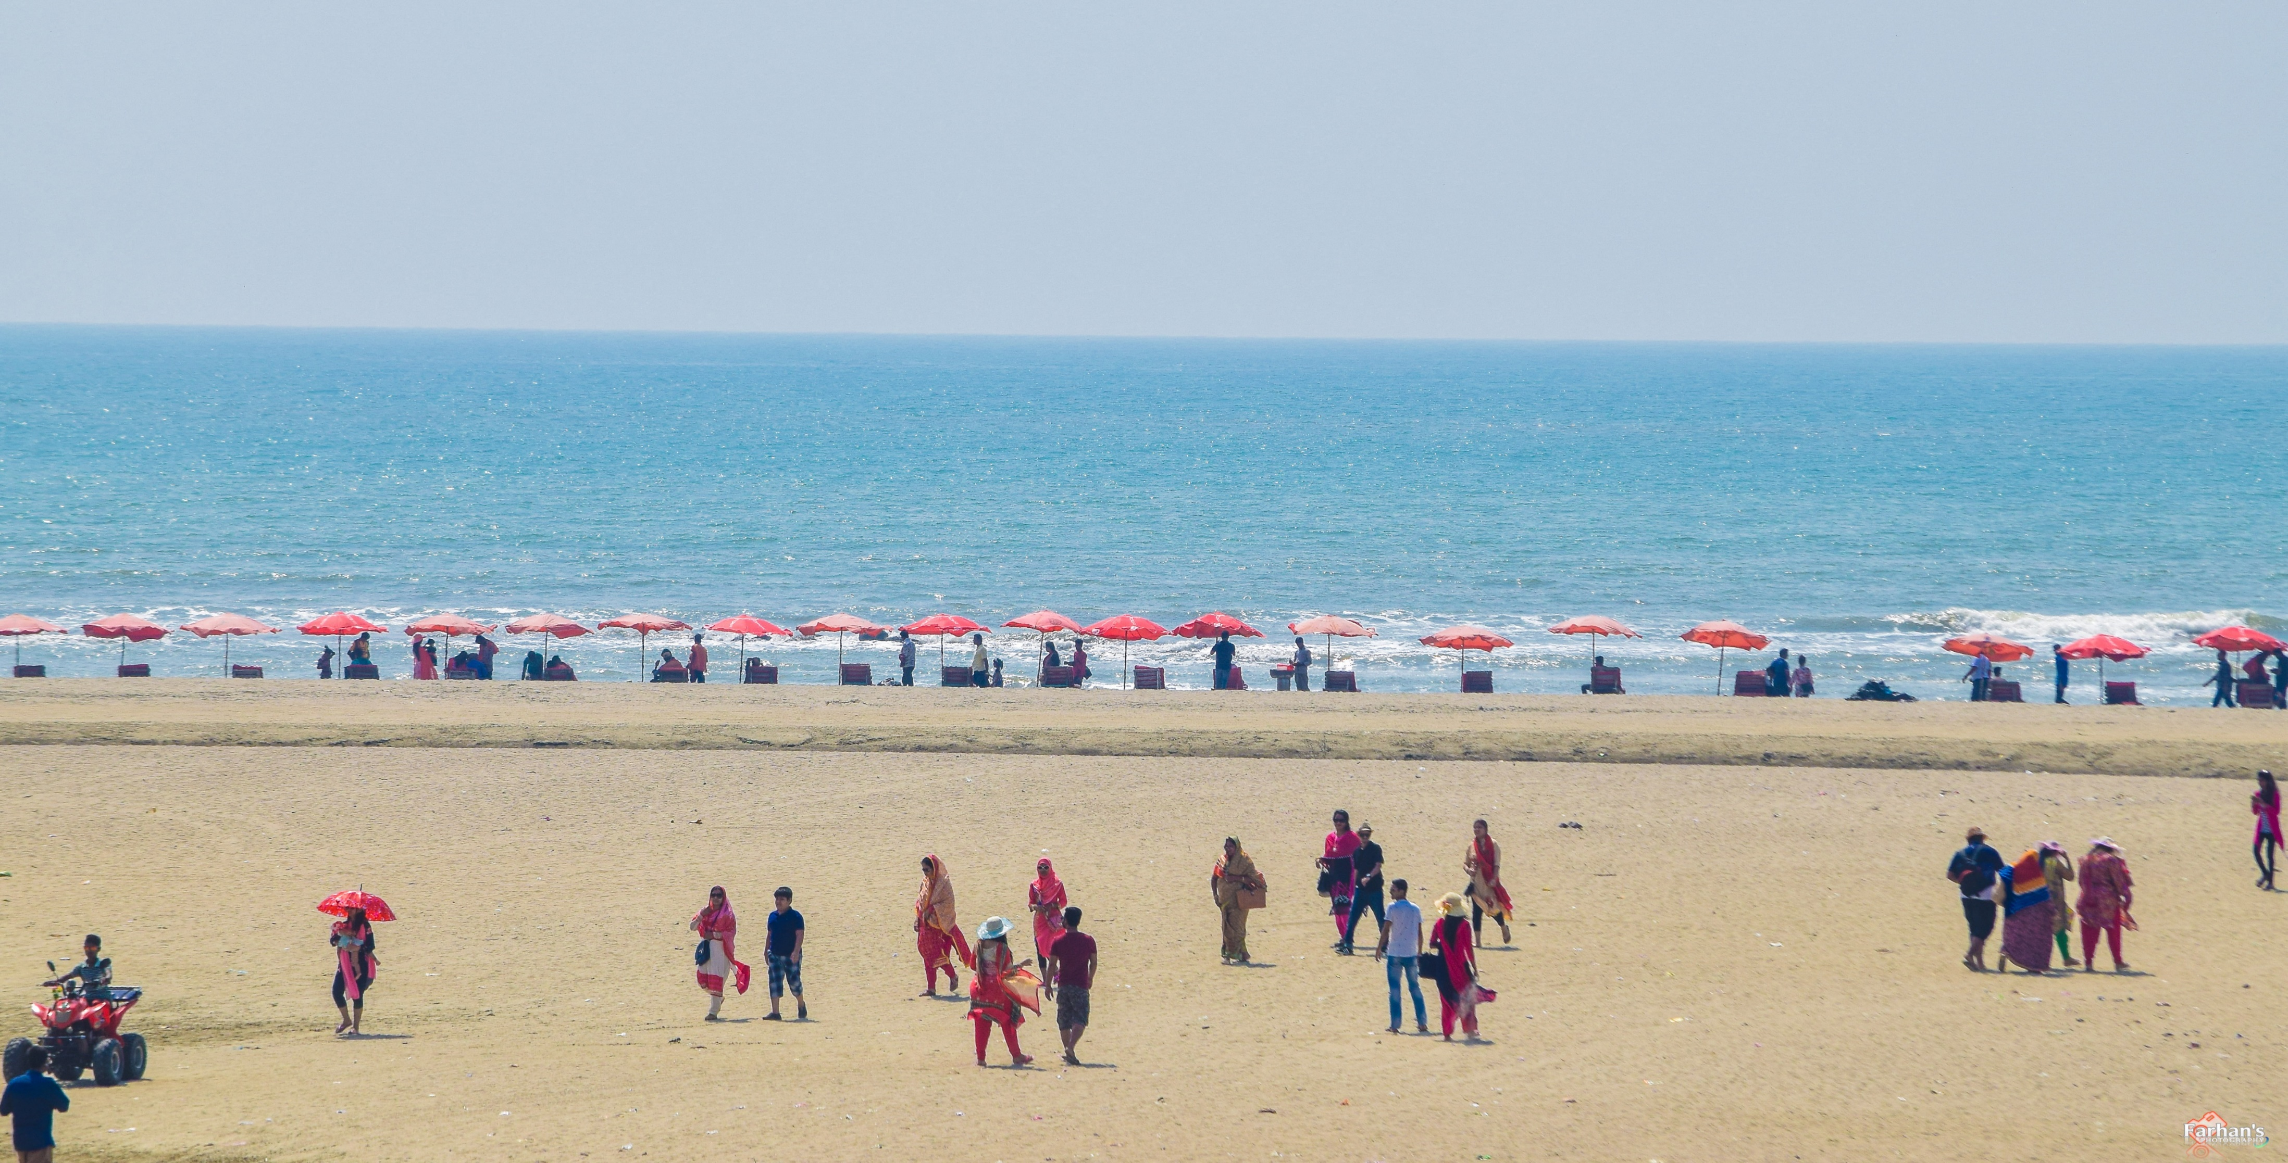
BANGLADESH
800+ Tourist Spot

Slide 4
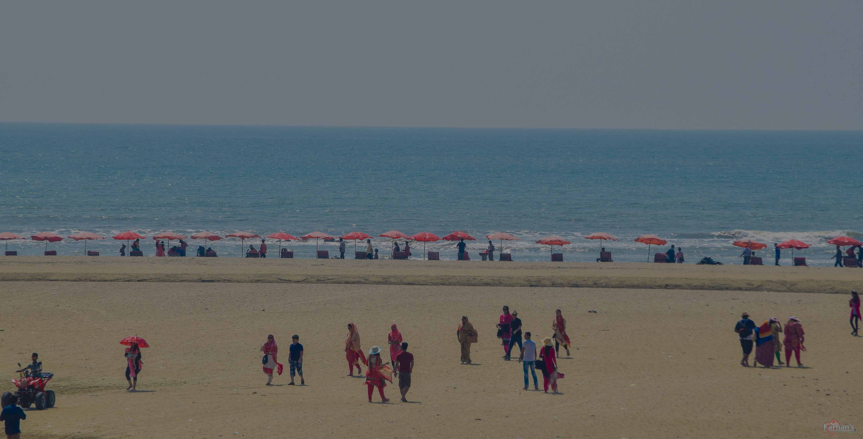



BANGLADESH
2016
2017
2018
Tourist
Tourist
Tourist
35 Million
56 Million
45 Million

Slide 5
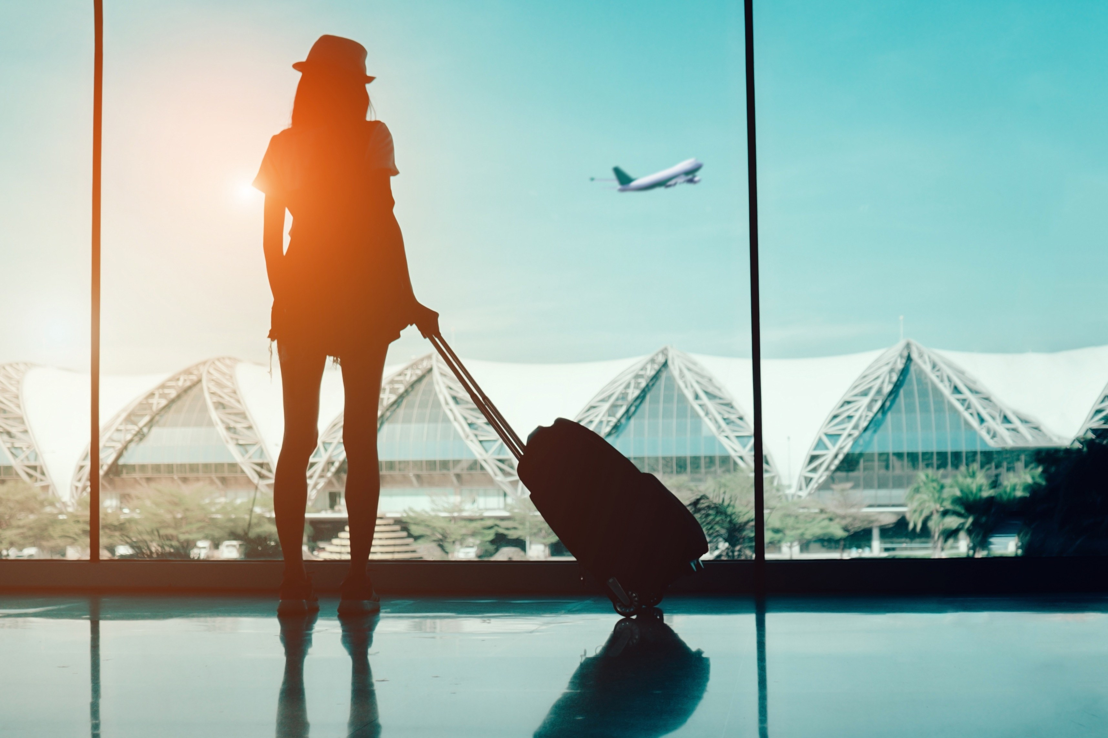


There is no Place to Keep Baggage in tourist spot .
Creating a Place where people can keep their baggage's in tourist spot.
Problem
Solution

Slide 6
How we Developed Our MVP
Business Canvas Model
Take Interview
Make Hypothesis
Reversed BCM
4 Different Places
55+
Charabagh, Savar
National Zoo
Banani
DIU campus

Slide 7
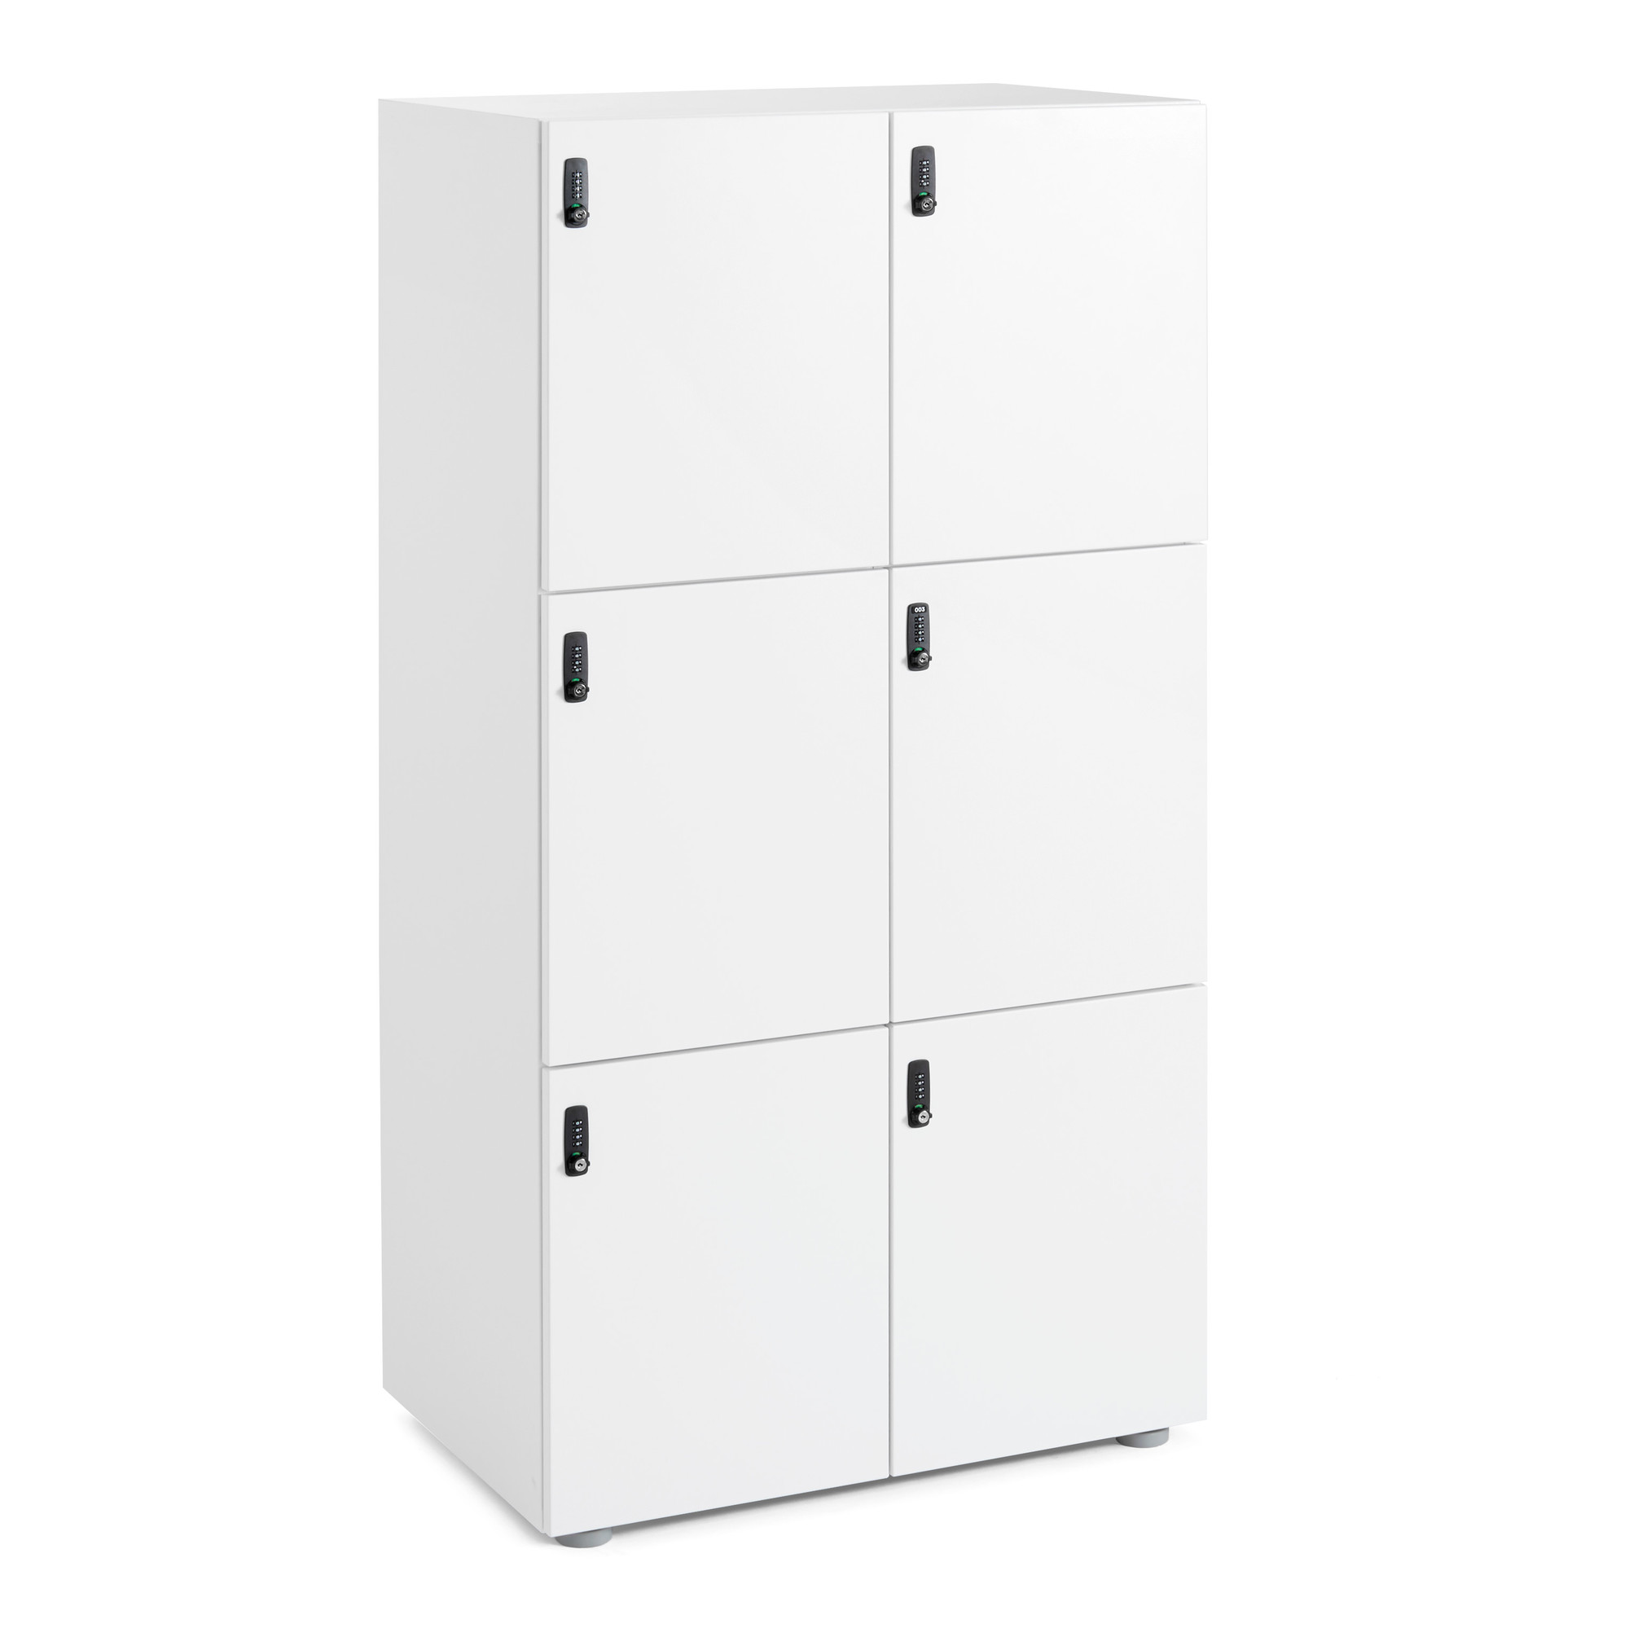
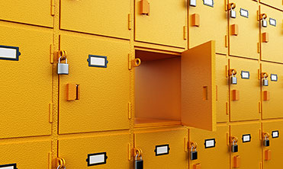
Key Locker VS Smart Locker

Slide 8
How Our Services Work
Smartphone App
Tracking
People have to use our smartphone apps to use our services.
People can track their Locker from anywhere. If some one trying to open a locker they get automated SMS.
Online Payment
Easy to Find
Easy Prepaid system
By our apps people can easily find the nearby locker and the locker status also.
BOGANI
Easy Payment
People can easily pay their bill through Bkash and DBBL account and Master Card.
Keep things Safe

Slide 9
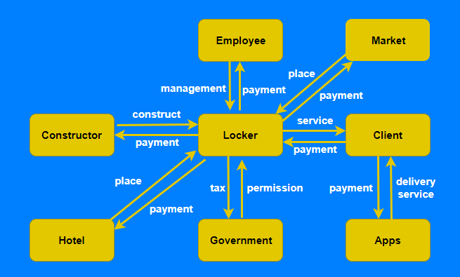
Workflow

Slide 10
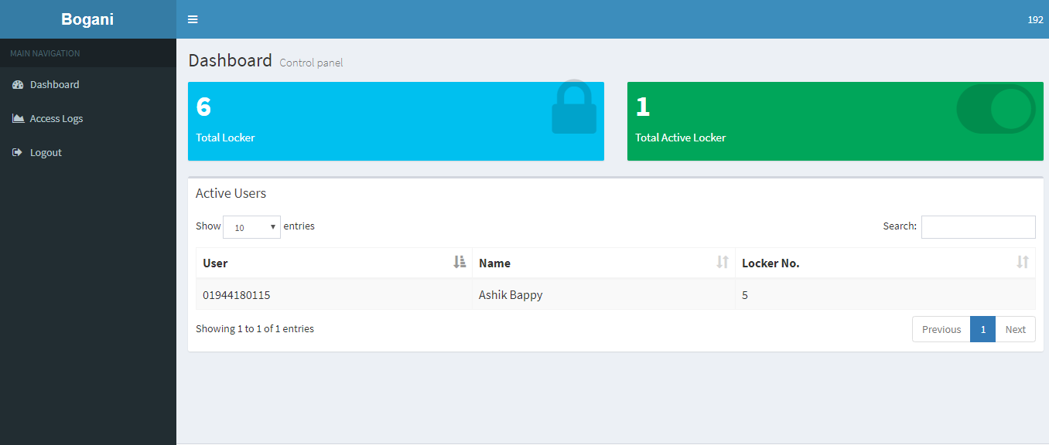
ADMIN DASHBOARD

Slide 11
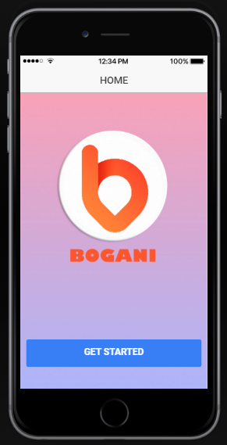
OUR APP

Slide 12

How we Reach the Customer?
Through Online

Slide 13
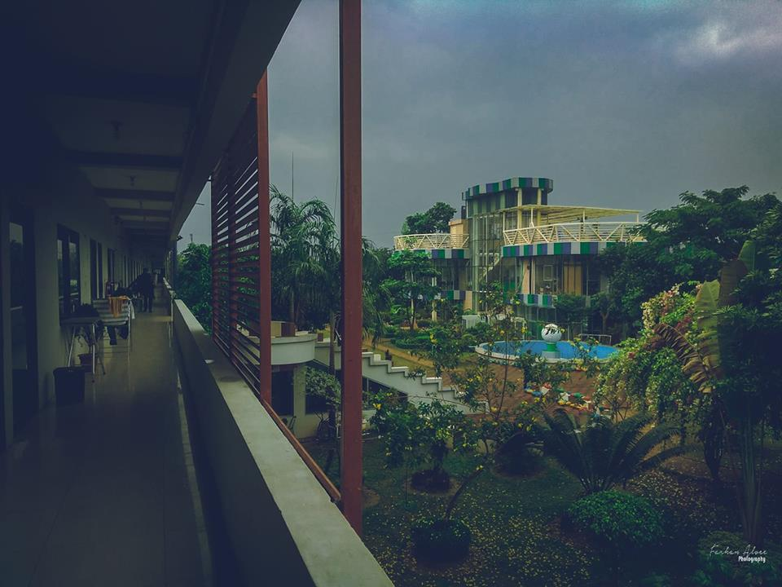
SWOT ANALYSIS
O
S
T
W
*Local Hotels
*Limited Customer
*Server Error
*Reasonable Price
*Easy to Use
*User friendly apps
*Job Opportunity for Unemployed Peoples
*Setup Costs
*New Business
*No Reputation
OPPORTUNITIES
STRENGTHS
THREATS
WEAKNESSES

Slide 14
Financial Analysis
Amount
Benefit Per Day
Land & Ownership cost | 700m2 | 1100000
Setup Cost | 40 lockers | 100000
Apps Cost |  | 300000
Transportation cost |  | 300000
Internet Cost |  | 12000
Electronic Cost |  | 30000
Promotion Cost |  | 25000
Employee Cost |  | 540000
Maintain Cost |  | 10000
 | Total= | 2417000
Price : 400tk
Cost : 165tk
Reached Break Even Point
1 year

Slide 15


Slide 16
Thankyou

